Slide 1
Month 6
REFLECTION

Slide 2
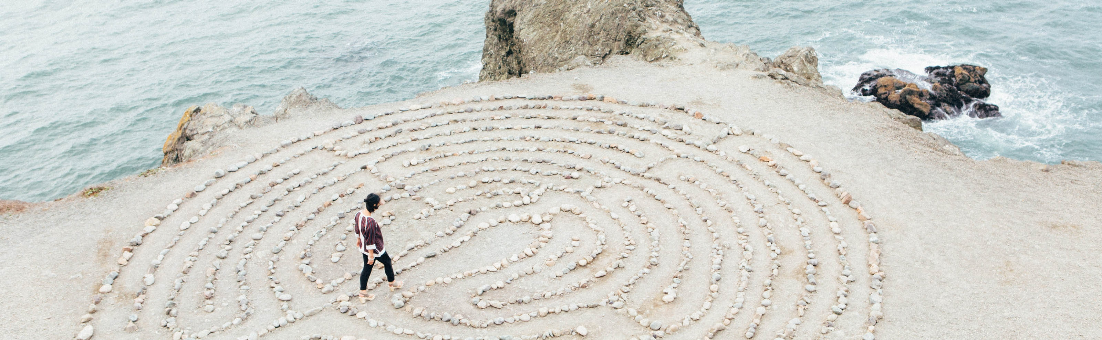
“
Like water which can clearly mirror the sky and the trees only so long as its surface is undisturbed, the mind can only reflect the true image of the Self when it is tranquil and wholly relaxed.
-Indra Devi
“

Slide 3
REVIEW
WHAT WE’VE LEARNED SO FAR:
Journey with Reiki
Distant journey techniques
Listening
Intuition
5 steps to manifestation
Conscious Choice

Slide 4
Why do we reflect?

Slide 5
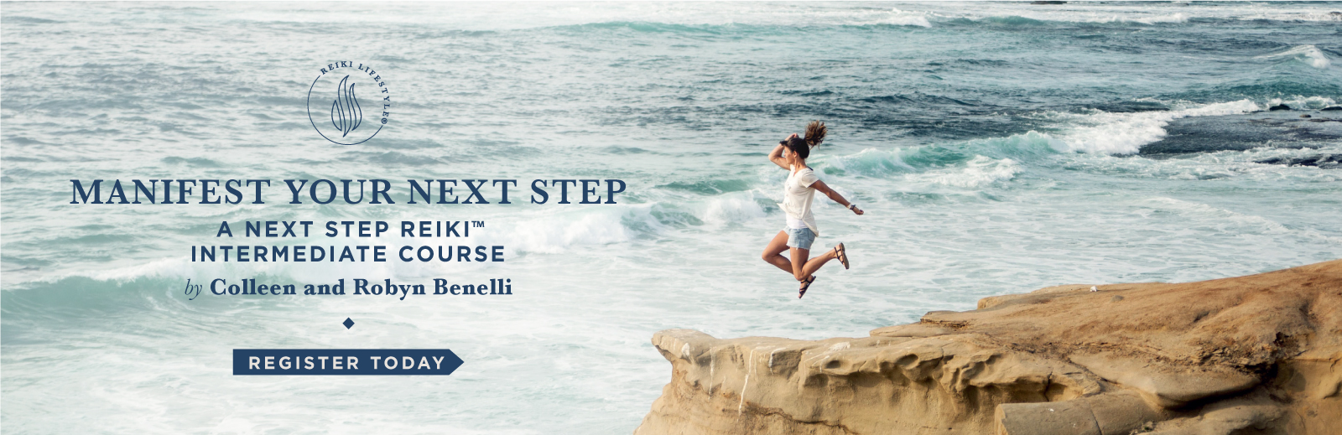
Manifest Your Conscious Actions
You’ve Discovered Your Next Step intentions, now what?
How do you manifest intentions through solutions, actions, and choices?
Can’t get enough Reiki Skill Training?
Starting June 12th

